Slide 1
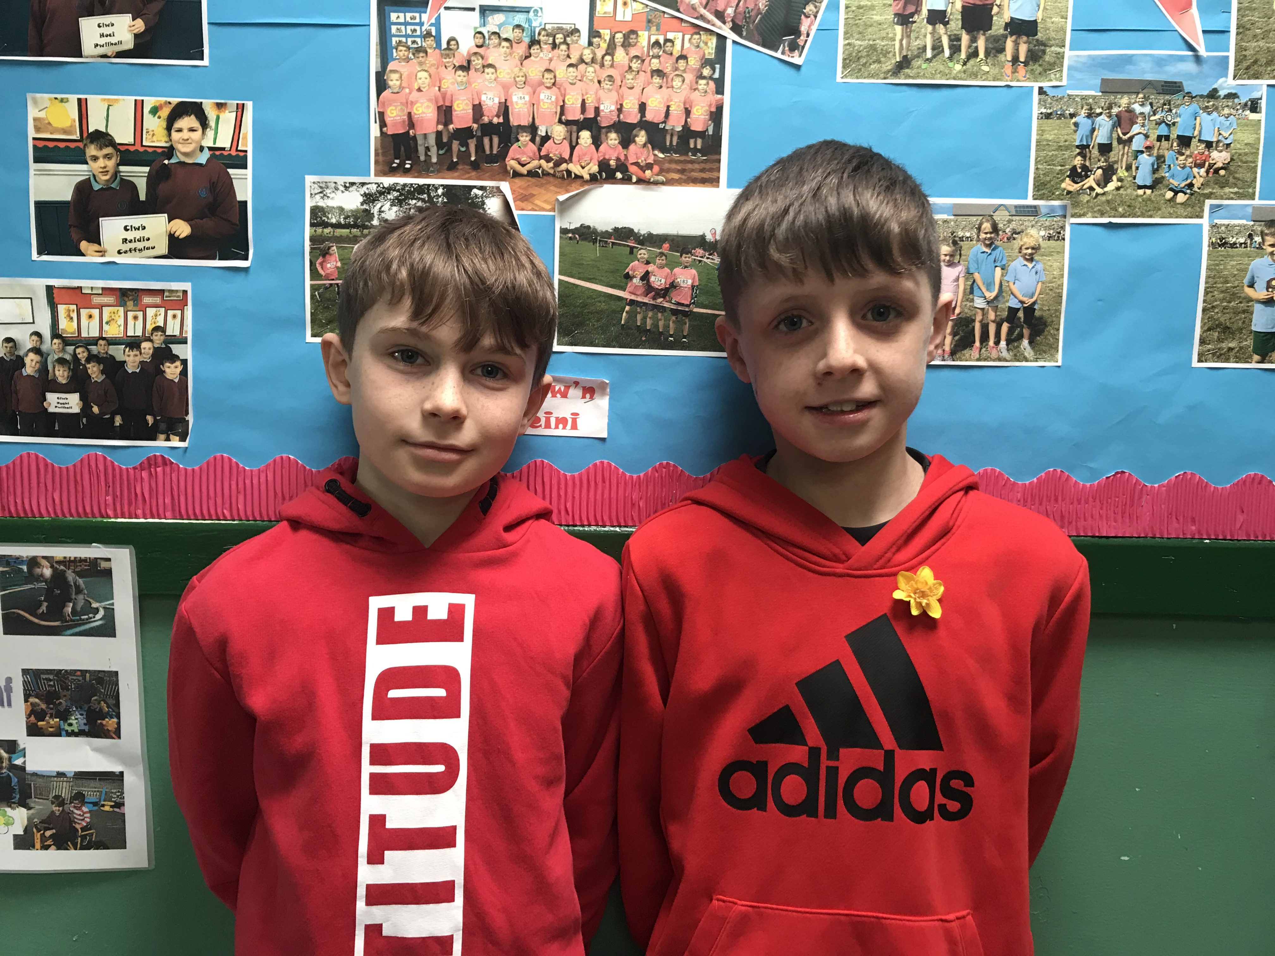

Bronze Ambassadors
2019 - 2020
Cian and Moi

Slide 2
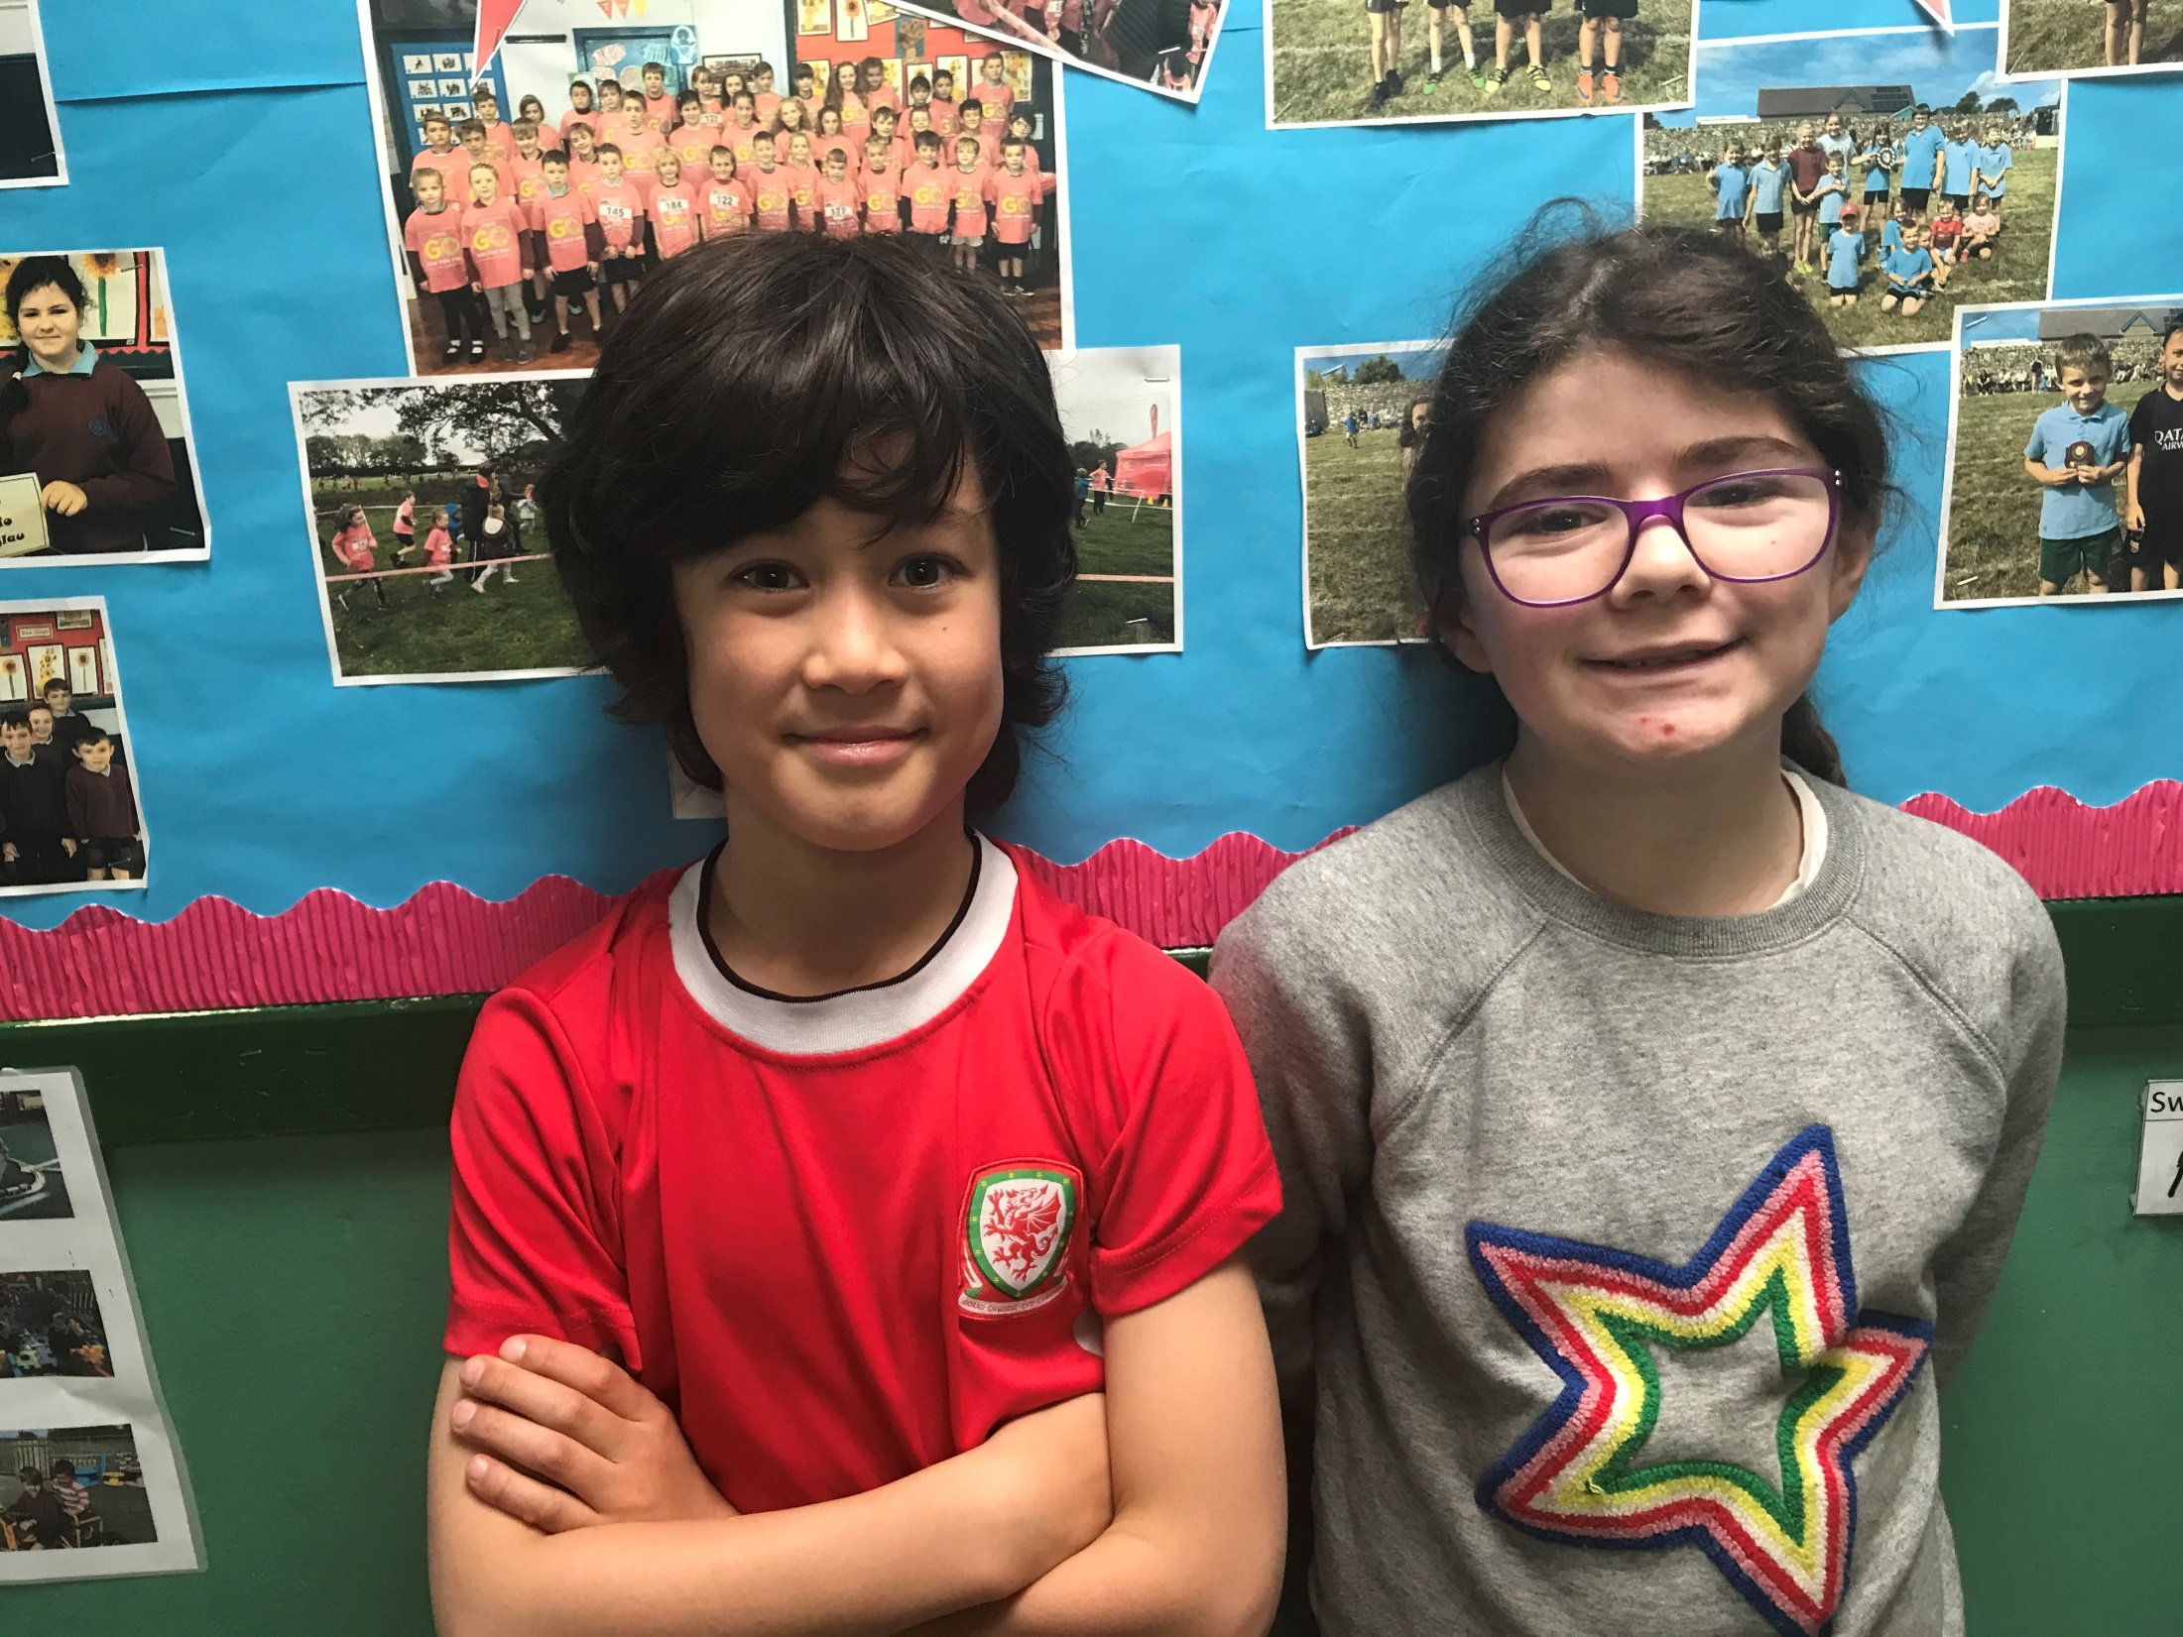
Road Safety
Representatives
2019 - 2020
Denis and Nansi

Slide 3
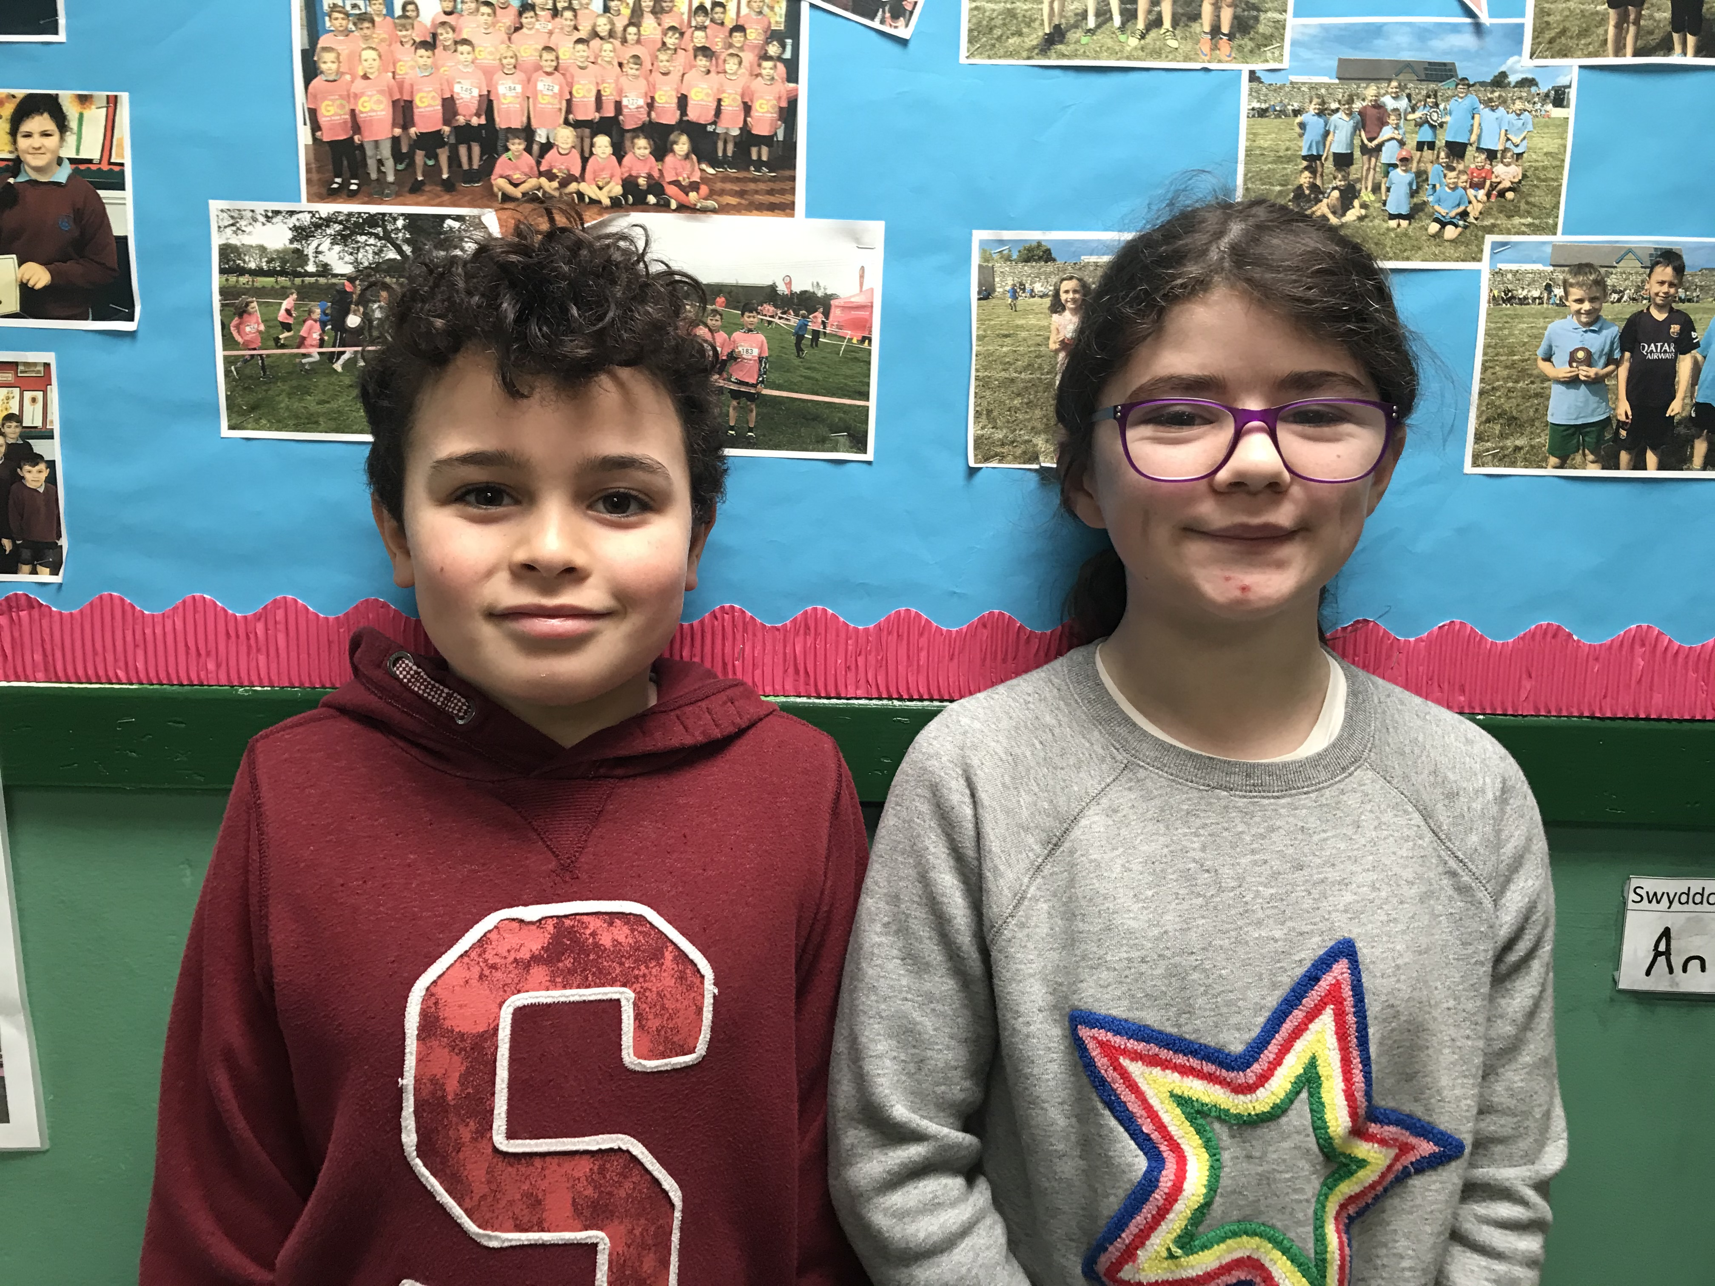
Language Dragons
2019 - 2020
Nansi and Noa

